Slide 1

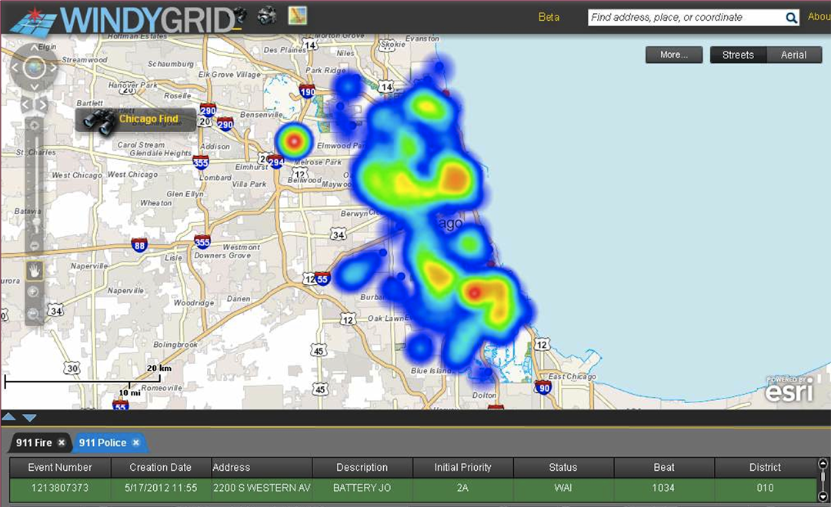


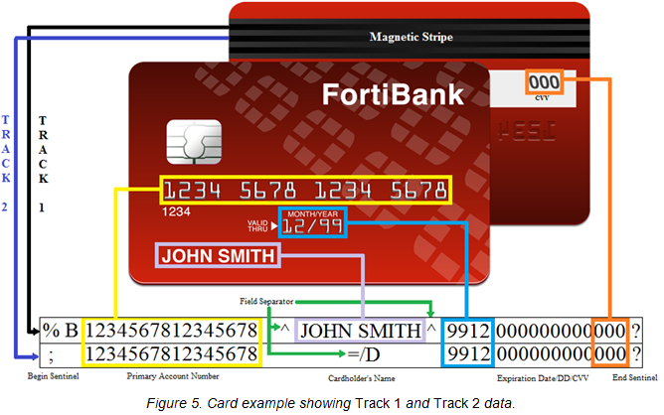


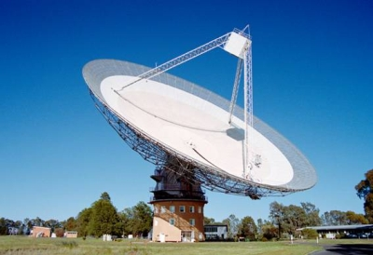
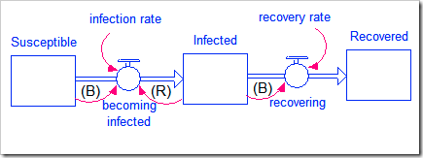
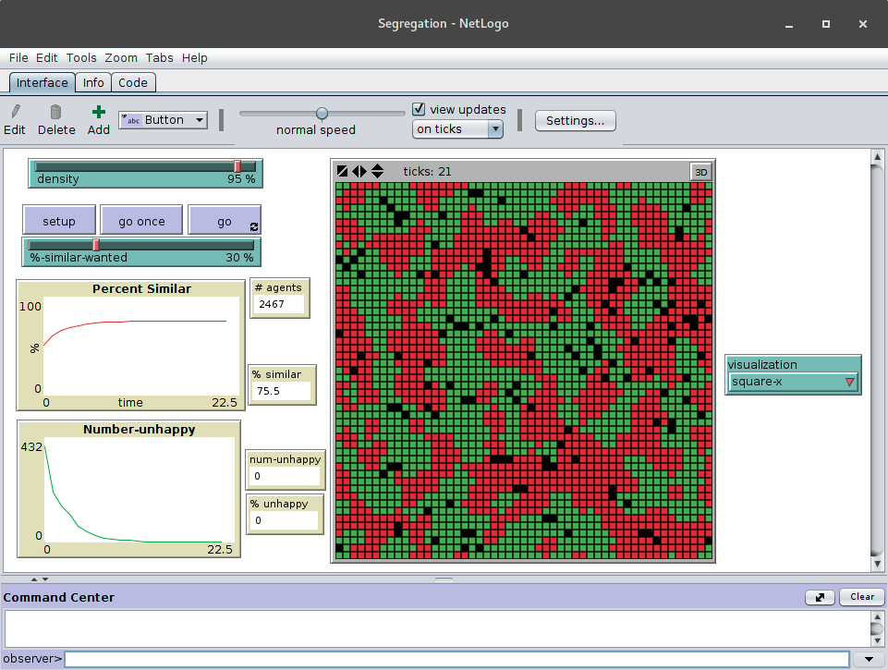
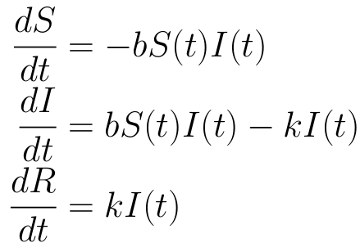
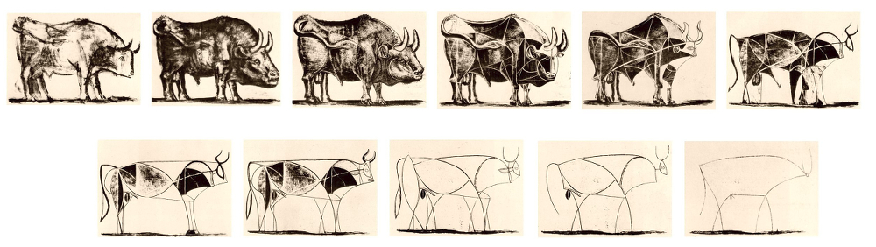
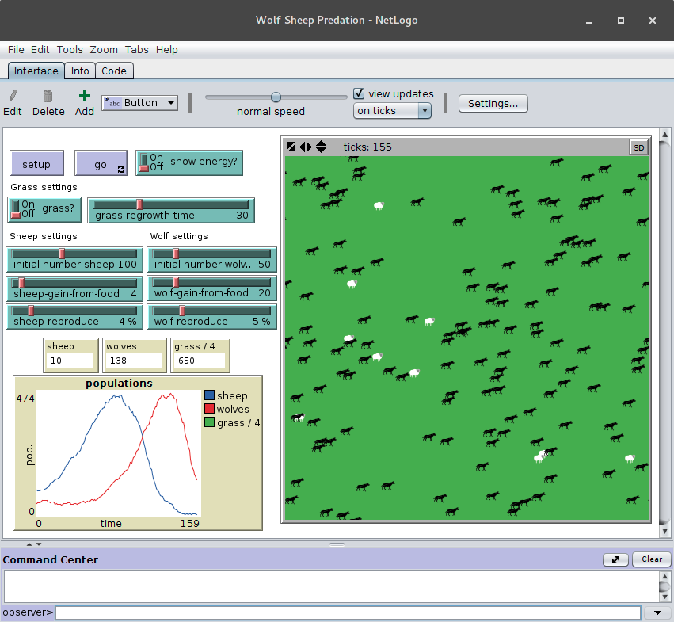
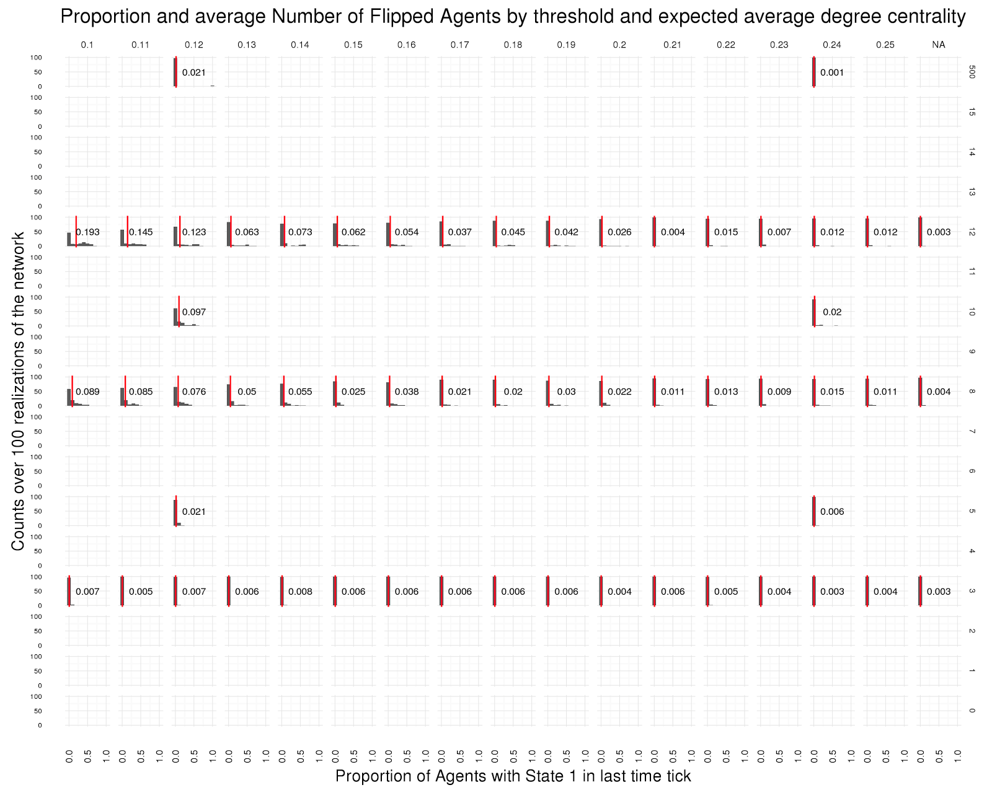
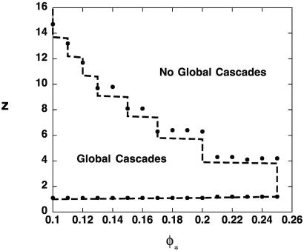
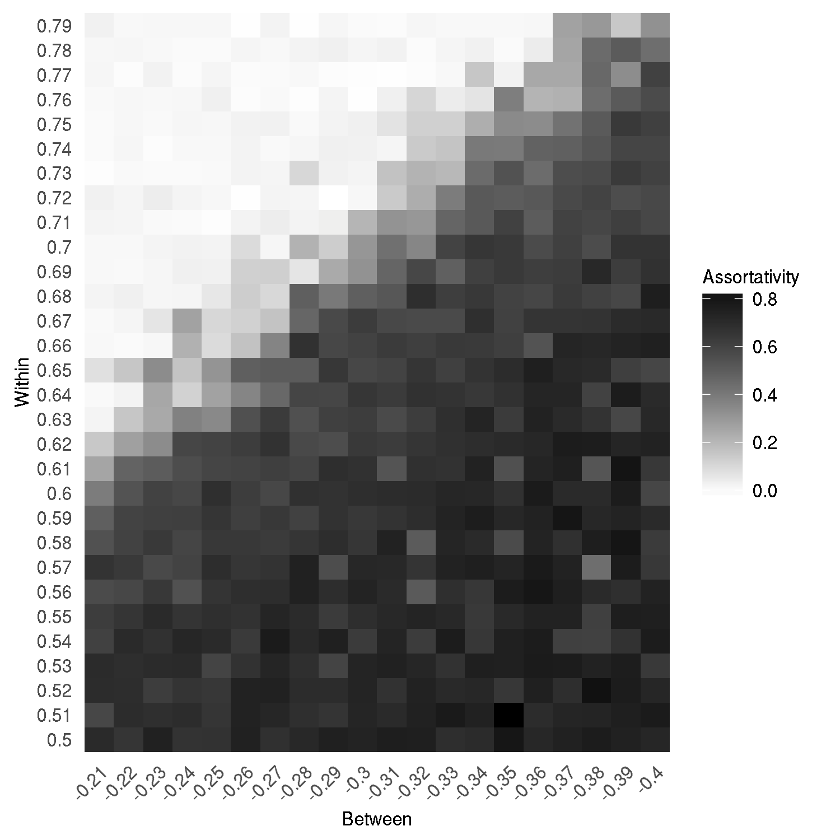
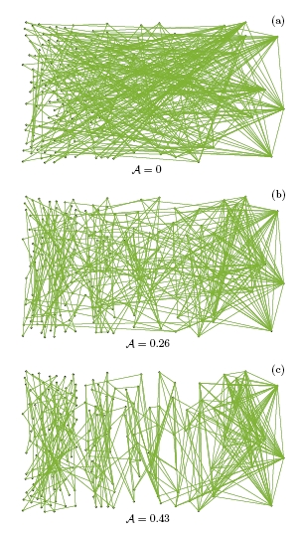
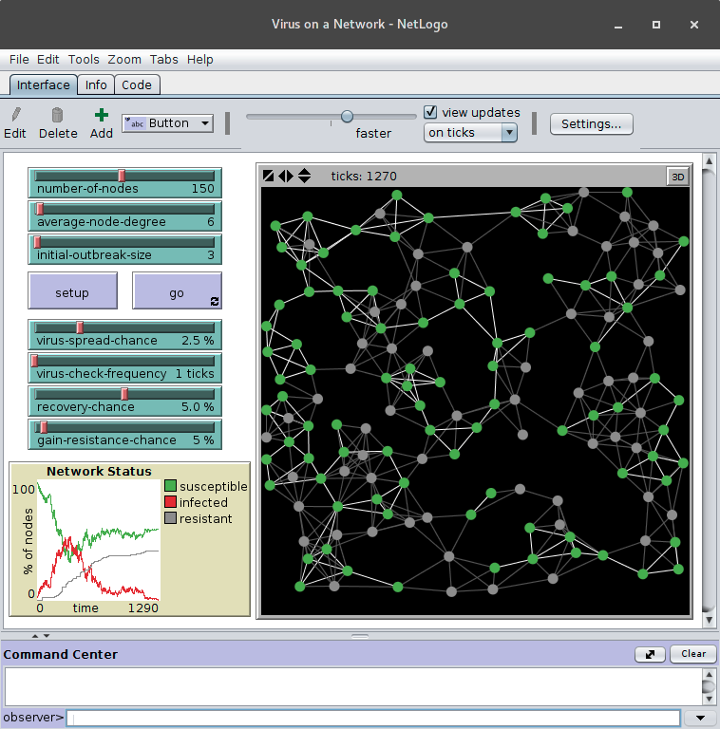
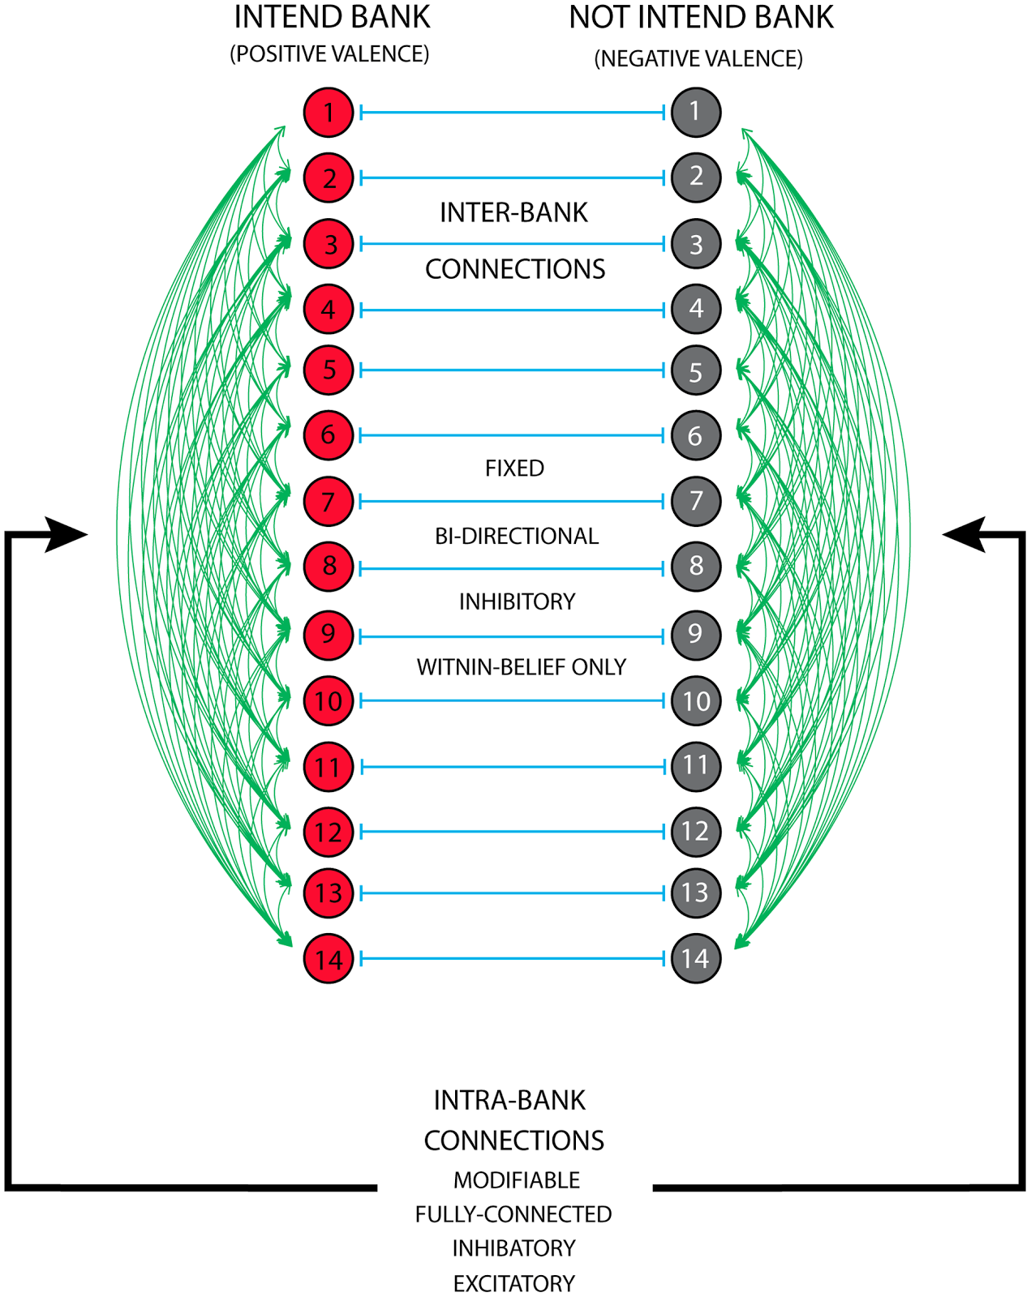
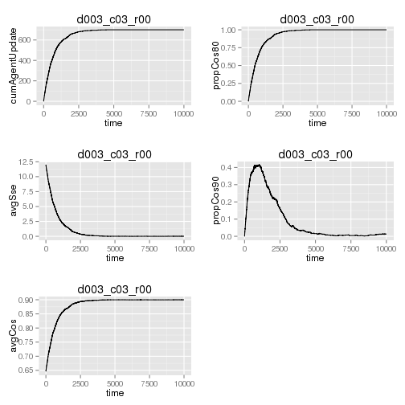



Overview
Understanding Social Diffusion Dynamics Using Networked Cognitive Systems
bi.vt.edu/sdal
Daniel Chen, Kathryn Ziemer, Mark Orr
Two approaches to explaining social diffusion dynamics:
Network Science:
Individuals are connected to other individuals
Network topology
Diffusion is a function of an individual's connected neighbors
Cognitive Science:
Individuals process information from external input
Model of an individual
Diffusion is a function of how individuals process inputs
Multi-Agent Neural-Network (MANN)
A simulation platform to combine network science and cognitive science to explore social diffusion dynamics using a networked cognitive systems approach.
Agent-based modeling platform built in Python
Networks are created with networkx
Neural networks are created in using LENS (Light, efficient simulator)
Open Source under a MIT license
Criterion | Description | Class
Process-Oriented / Mechanistic | Postulates mental constructs and their interactions | Operations
Dynamic | Representation of change over time and, potentially, interfaces dynamically with social contexts and environment
Learning | Aspects of the model can change permanently over time
Individual Differences | Das the capacity to represent systematic and theoretically important variation in behavior across individuals | Variation
Theoretical Grounding | Processes and constructs are grounded and constrained by neuroscientific psychical, or behavior economic theory | Development
Empirical Grounding | Proper comparison in empirical (most likely experimental) data to include testing of novel predictions. Ideally, a wide variety of experimental conditions would be considered
Computational Implementation | A formal model of the operations and drivers of variation that also represents its theoretical basis in a way that is empirically comparable to human experiment and observation
Designed Data Collections
Statistically designed and intentional observational data collections
Administrative Data
Data collected for the administration of an organization or program
Opportunity Data
Data generated as we move through our daily paces
Procedural Data
Data derived from policies and procedures
Relatively Simple
Deterministic
System Dynamics
Homogeneous
Veracity and Value
Social and Behavioral Data Flows
Understanding Social Diffusion Dynamics Using Networked Cognitive Systems
Degree (z) | Threshold (φ) | Vulnerability
High | High | Low
High | Low | High
Low | High | Low
Low | Low | High
Stochastic
Consolidate knowledge
Heterogeneous
Governance, Structure, and Quality
Challenge and Opportunities
Containerization (Docker)
This poster (and references): https://github.com/chendaniely/2017_ser_poster MANN code: https://github.com/chendaniely/mann2,
https://github.com/chendaniely/mann2_simulations,
https://github.com/chendaniely/mann
bi.vt.edu/sdal
NSF Interdisciplinary Behavioral and Social Science Research:
Understanding Social Diffusion Dynamics Among Networked Cognitive Systems (#1520359)
@chendaniely
http://orcid.org/0000-0003-3857-1741
bi.vt.edu/sdal

